Slide 1

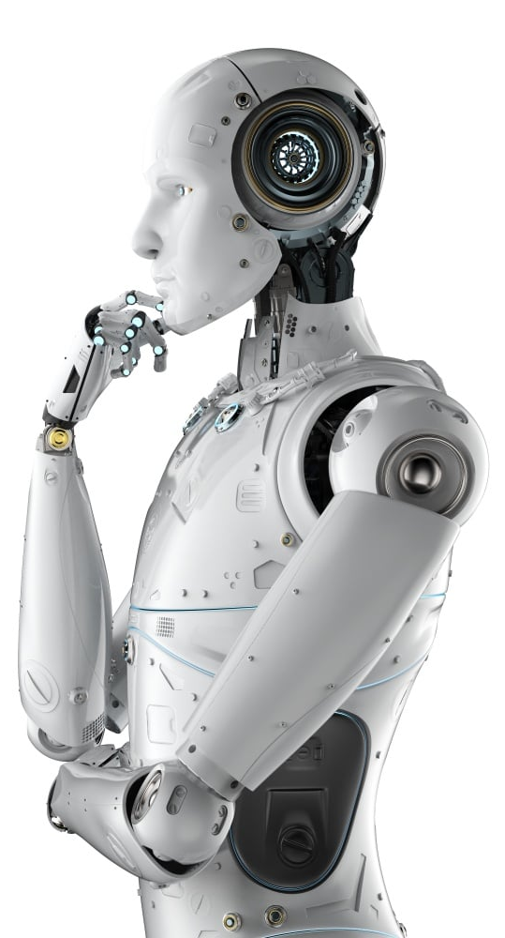
BootCamp on Artificial Intelligence-Computer Vision
Age and Gender Detection using OpenCV
Session will be start around 11 AM

Slide 2
Ready For Session
Age and Gender Detection using OpenCV

Slide 3

Age and Gender Detection
Age and Gender Detection using OpenCV refers to the process of analyzing images or video frames to estimate the age and determine the gender of individuals present in the visuals.
OpenCV (Open Source Computer Vision Library) is widely used in computer vision applications and provides various tools and algorithms for image processing, including pre-trained models that can detect faces and classify age and gender.

Slide 4
Models for face detection
"opencv_face_detector.pbtxt"
#configuration file that describes the model's architecture
"opencv_face_detector_uint8.pb"
#TensorFlow pre-trained model file used to detect faces
"age_deploy.prototxt"
#file that defines the architecture of the age detection network
"age_net.caffemodel"
#pre-trained Caffe model file that contains the weights
"gender_deploy.prototxt"
#file that defines the architecture of the gender detection network
"gender_net.caffemodel"
#pre-trained Caffe model file that contains the weights

Slide 5
Ready For Hands-On
Age and Gender Detection using OpenCV

Slide 6




THANK YOU☺
NOVITECH COIMBATORE
novitechresearchanddevelopment
Join our Community to clarify your doubts

